Slide 1

Lecture 2
Technology of preparation of colloid systems.
Preparation of disperse systems and their degradation.
Methods of purification of disperse systems.
Adilbekova A.O

Slide 2
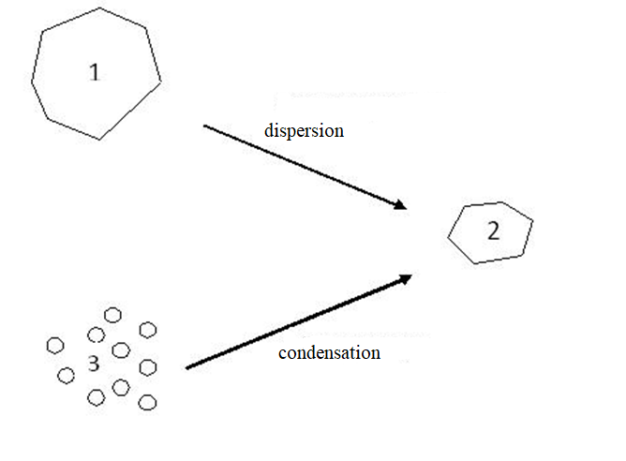
Dispersion methods:
Colloidal mills.
Ultrasound treatment
Electric dispersion
Peptization
Condensation method:
Physical condensation
(solvent displacement, condensation from vapours)
Chemical condensation

Slide 3
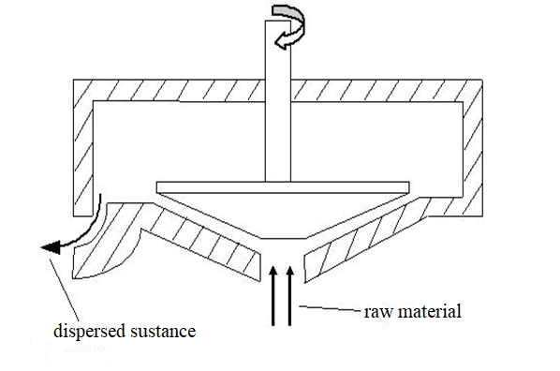
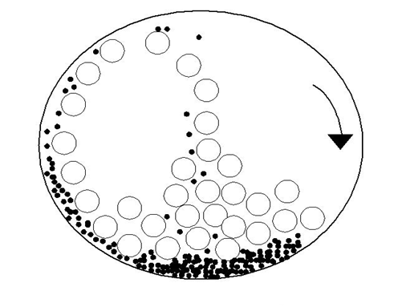
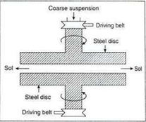
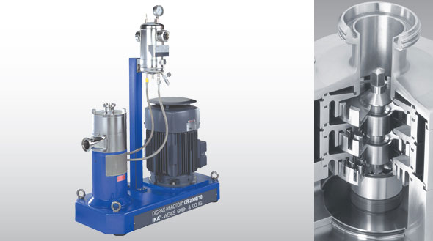
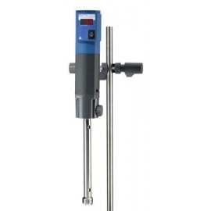

Slide 4
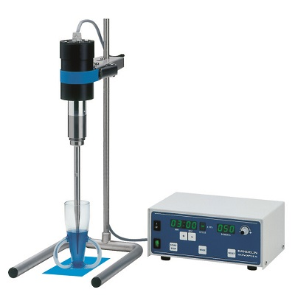
The sound waves of high frequency are usually called ultrasonic waves. Ultrasonic waves are passed through
the solution containing larger particles. They break down to form colloidal solution.

Slide 5
The dispersion of a precipitated material into colloidal solution by the action of an electrolyte in solution is termed as peptisation. The electrolyte used is called a peptizing agent.
(Silver chloride can be converted into a sol by adding hydrochloric acid; Ferric hydroxide yields a sol by adding ferric chloride)

Slide 6
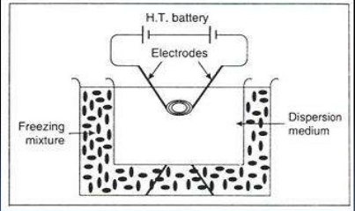
Bredig arch method
In this method two metallic wires functioning as electrodes are immersed into water, then on both ends of wires is given a strong enough electric current to be evaporated and then it is dispersed into water to form a metallic sol.

Slide 7
Physical condensation methods.
Method of physical state change.
The base of this method is the separation of the new phase particles from vapour (at condensation) or from a liquid (at crystallization).
A necessary condition for physical condensation is the deviation of an initial homogeneous system (vapour or liquid) from the state at some particular temperature or pressure. Colloidal solutions of sulphur are obtained by passing their vapour through cold water containing a stabiliser.
Method of solvent replacement. If a solution of sulphur or phosphorus in alcohol is poured into water, a colloidal solution of sulphur or phosphorus is obtained due to low solubility in water.

Slide 8
Chemical condensation methods. The chemical methods involve chemical reaction in a medium in which the dispersed phase is sparingly soluble.
HAuCl₄ +2K₂C0₃+H₂O = Au(OH)₃+2CO₂+4KCl
2Au(OH)₃+K₂CO₃ = 2KAuO₂+3H₂O+CO₂
2KAuO₂+3HCOH+K₂CO₃ = 2Au+3HCOOK+KHCO₃+H₂O
Another example is preparation of Prussian blue solution and formation a ferric hydroxide sol:
4FeCl₃+3K₄[Fe(CN)₆] = Fe₄[Fe(CN)₆]₃+12KCl
FeCl₃+3H₂O =Fe(OH)₃+3HCl

Slide 9
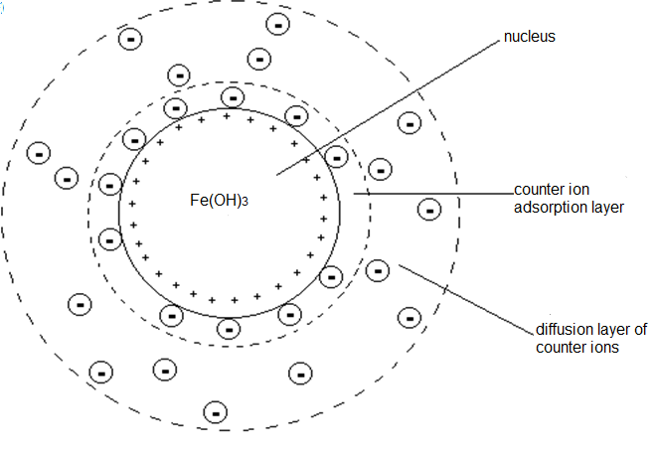
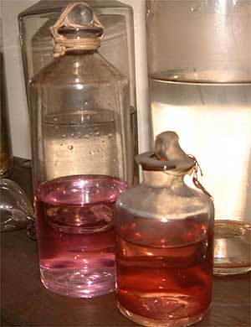
{m Fe(OH)₃ (n)Fe ³⁺ 3(n-x)Cl ⁻}x Cl ⁻

Slide 10
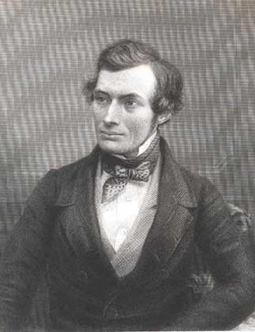
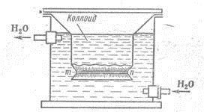
Thomas Graham. Dialysis.
Scheme of simple dialyzer

Slide 11
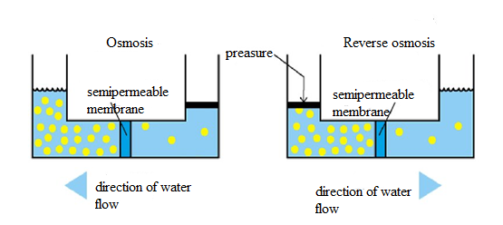
High pressure dialysis - ultrafiltration.
Filtration at increased pressure through membranes with even finer pores, such as cellulose acetate (about 10-9 m), not only dispersed particles are delayed, but also dissolved molecules and electrolyte ions.
Hyperfiltration or reverse osmosis.

Slide 12
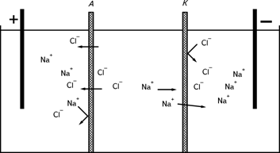
When electrolytes are removed, the dialysis process can be accelerated by applying an external electric field - electrodialysis.
Electrodialysis is also used for desalination of sea, river, lake waters, for industrial wastewater treatment.

Slide 13
Questions?
Thank you for your attention!
https://poznayka.org/s69733t1.html
https://en.ppt-online.org/349621
http://www.mediana-filter.ru/kh6_1.html

